Slide 1
JPB Liberty
Web 3.0 Litigation Funding
Using Web 3.0 technology and financing to defend the Crypto Industry

Slide 3
Our Mission
JPB Liberty seeks to preserve freedom and liberty in the online world.
Decentralised, distributed applications & projects and cryptocurrencies represent the future of online freedom, privacy and democracy - a Web 3.0.
JBP Liberty has been established to fund class action litigation against those who attack the Crypto Industry unlawfully and other wide scale abuses of power.

Slide 4
What is Web 3.0 Litigation Funding?
Enables “No Win No Pay” Class Actions outside the US
JPB Liberty pays all costs of litigation and manages lawyers
Funded by token sale
Token holders get 25% of total damages
Tokens are listed on exchange(s) providing liquidity as case progresses through Courts
Litigation funding (including token sale) exempt from Australian securities laws

Slide 5
Class Action Against Facebook & Google’s Crypto Ad Ban
Ban breaches Australian Competition Law (anti-trust)
Crypto projects affected by ban are competitors of Facebook & Google
Facebook & Google (AU subsidiaries and US/Irish parents) can be sued for worldwide damages
Who has a claim?
Anyone worldwide in the Crypto Industry
Anyone worldwide who owned cryptocurrency when bans were announced
What does it cost to join?
Nothing – Its No Win No Pay
Bonus tokens for signing up
the bigger the claim the more bonus tokens

Slide 6
Web 3.0: A threat to Facebook & Google
Google & Facebook’s strategic business model is to buy promising tech companies before they get big enough to be serious competitors
Gets around traditional anti-trust merger rules
Both have bought hundreds of companies
Web 3.0 represents competitors who can’t be bought!
Decentralised, crypto based projects are NOT companies that can be bought
Utility Tokens do NOT give ownership of business enterprise
Token value comes from demand (volume of transactions) vs limited supply – not profits
Initial controlling entities are not for profit foundations – can’t be bought
Web 3.0 is a challenge to Facebook & Google’s core revenue model
monetising their users’ data via selling advertising (sometimes the data too!)

Slide 7
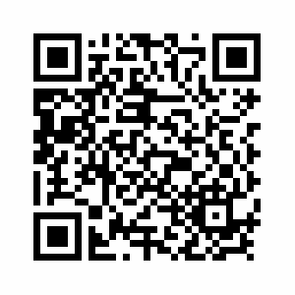
Take a stand against the Crypto Ad Ban!
Help defend online freedom, privacy & democracy
Sign up to the class action against Google and Facebook
Contact Details
Andrew Hamilton
Andrew@jpbliberty.com
054 536 3529
www.jpbliberty.com

